Slide 1
Presentation on
Survival Analysis

Slide 2
Group Member
Pranta Kumer Bhuiyan(151-15-5413)
Parves Ahmed Moon(151-15-5405)
Md. Ali Akbar(151-15-5460)
Md.Shahed Uddin Emon(151-15-4759)

Slide 3
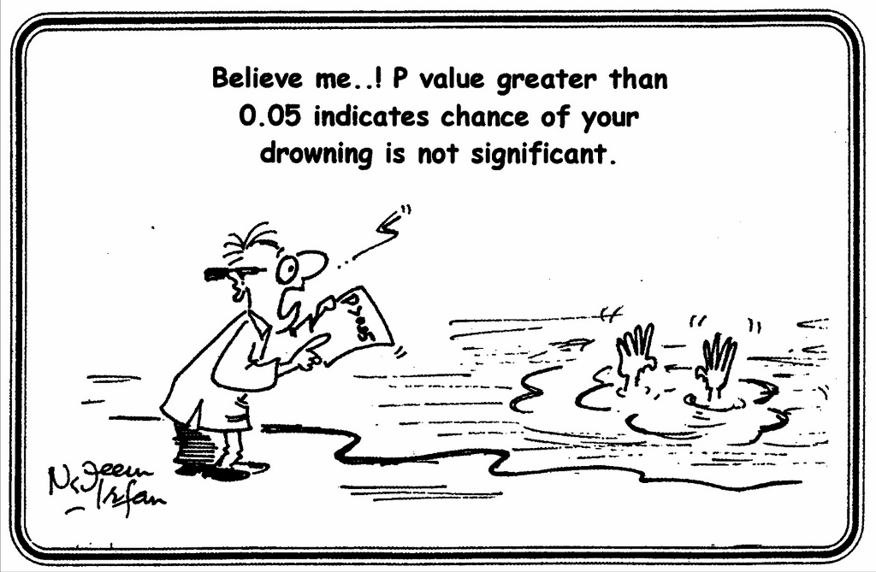
Survival Analysis

Slide 4
Our Aim
In this project we are interested in how long drafted NFL players are in the league, so the event of interest will be the retirement of drafted NFL players. to estimate the survival function and construct the survival curve for an NFL career.
Factor: duration,retired

Slide 5
Survival Function
S(t)=Pr(T>t)

Slide 6

Kaplan-Meier Estimator

Slide 7
Data
We take data from 2007 to 2017 volume of 2796.

Slide 8
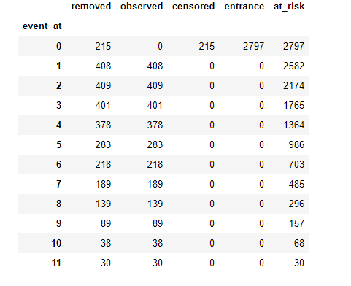
Event Table

Slide 9

Estimating Using Kaplan-Meier

Slide 10
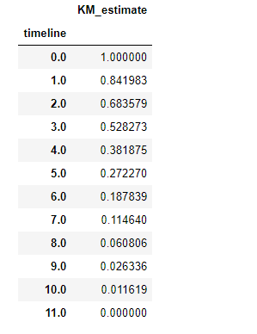
Estimated Values

Slide 11
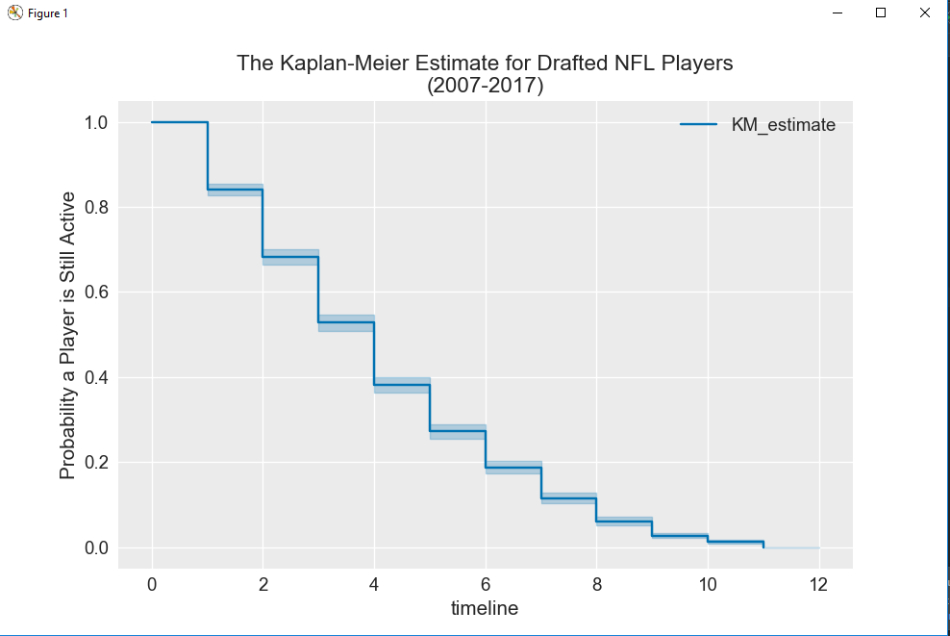
Graph

Slide 12
Not Done Yet(Work in Process)
Estimate value for players in different position.

Slide 13
Reference
[1] https://www.cscu.cornell.edu/news/statnews/stnews78.pdf
[2] http://www.garfield.library.upenn.edu/classics1983/A1983QS51100001.pdf
[3]https://www.ncbi.nlm.nih.gov/pmc/articles/PMC3059453/
[4]https://lifelines.readthedocs.io/en/latest/index.html

